Slide 1

Quotes, Blocks, and Lists
The <q> element
The <blockquote> element
Block vs Inline
Lists
Entities

Slide 2

See Also
https://www.w3schools.com/html/html_blocks.asp
http://www.echoecho.com/htmllists01.htm

Slide 3
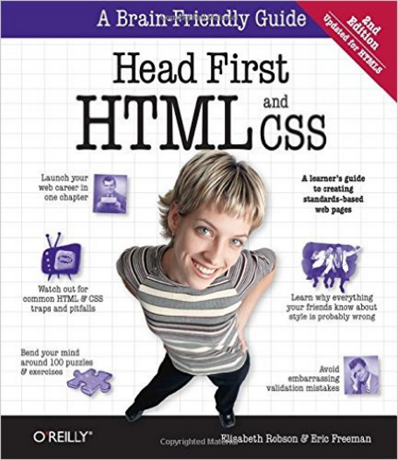
In the Book
Chapter 3:
Building Blocks

Slide 4
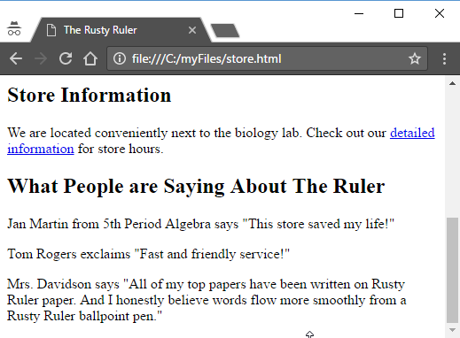
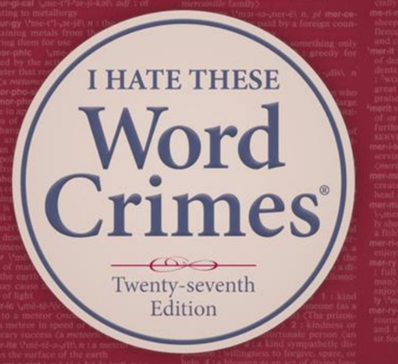
Testimonials
We are adding a testimonial section to the store’s “main” page.
main
How do we format quotes?
Never use quotation marks for emphasis.
“Weird “Al” Yankovic
Notes:
Ask Mrs. Davidson. Well, she would first say never use quotations for emphasis.

Slide 5
Testimonials
We are adding a testimonial section to the store’s “main” page.
How do we format quotes?
Notes:
Ask Mrs. Davidson. Well, she would first say never use quotations for emphasis.

Slide 6
Testimonials
<h2>What People Are Saying</h2>
<p>Jan Martin says "This store saved my life!"</p>
<p>Tom Rogers exclaims "Fast and friendly
service!"</p>
<p>Mrs. Davidson says "All of my top papers have been
written on Rusty Ruler paper. And I honestly
believe words flow more smoothly from a Rusty
Ruler ballpoint pen."</p>
HTML encourages to describe WHAT something is and not HOW to draw it.
Notes:
Here we tell the browser to put quotes around quotes.
#1 But in many cases HTML allows us to tell the browser WHAT something is. Like <h2> and <p>. We want to thell the browser “this is a quote” and let it decide how to render it.

Slide 7
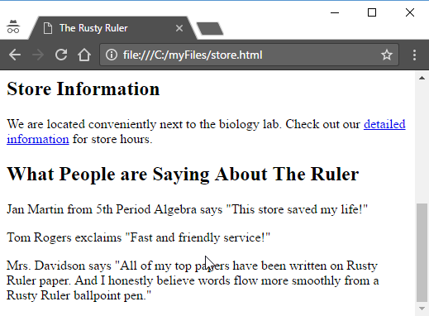
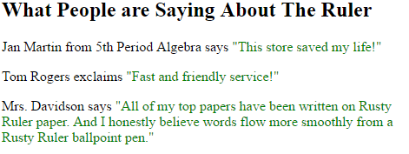
The Quote Element
<p>Jan Martin says <q>This store saved my life!</q></p>
<p>Tom Rogers exclaims <q>Fast and friendly service!</q></p>
<style>
q {color: green;}
</style>
Notes:
The <q> quote element wraps the quotes. You don’t put in the quotes.
#1 Replace all our quotes.
#2 And tada … it looks the same!
It is less typing with the quotes. But with a tag we can style quotes all over our site with one structure.
#3 Like this
All quotes change, but not other types of dialog that isn’t a quote from somebody.

Slide 8
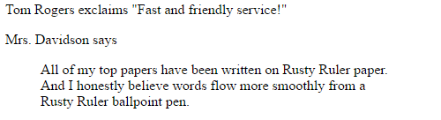
Block Quotes
<p>Mrs. Davidson says</p>
<blockquote>All of my top papers have been written on Rusty Ruler paper. And I honestly believe words flow more smoothly from a Rusty Ruler ballpoint pen.</blockquote>
Notes:
HTML provides two types of quotes. The <q> we just saw and the <blockquote> for longer quotes. Mrs. Davidson’s quote is a long quote.
#1 Here is how it looks in HTML
#2 And in the browser.
We can style the blockquote anyway we want, but the default style is indented on the sides.

Slide 9
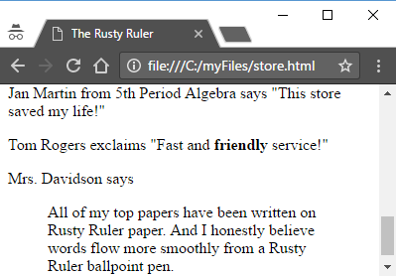

Emphasis
<p>Tom Rogers exclaims
<q>Fast and <b>friendly</b> service!</q>
</p>
<p>Tom Rogers exclaims
<q>Fast and <em>friendly</em> service!</q>
</p>
Notes:
Tom really emphasized friendly when he spoke. We want that emphasis to come out.
HTML has a “BOLD” tag. We can tell the browser how to print the word friendly.
Like this #1
But, HTML has a tag for emphasis. We tell HTML what this word is (an emphasis) and not how to draw it. The <em> for emphasis.
Like this #2
And on the screen #3
Whoa! That’s italics! Mrs. Davidson says emphasis can be expressed with italics or bold. Looks like the browser is using italics by default, though we could manually style it if we wanted.

Slide 10
Block and Inline
h1
Block elements have breaks above and below them.
Elements like <h1>, <h2>, <p>, <blockquote>, and others.
Return
h2
Return
p
em
img
q
Inline elements flow left to right and wrap to next line.
Elements like <q>, <em>, <img> and others.
Return
blockquote
em
Notes:
Two quotes in the same <p> would go side by side.

Slide 11
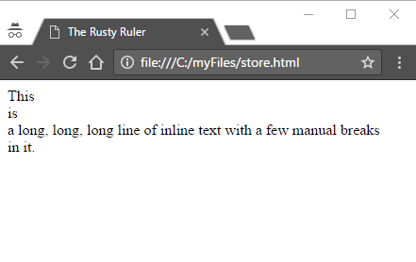
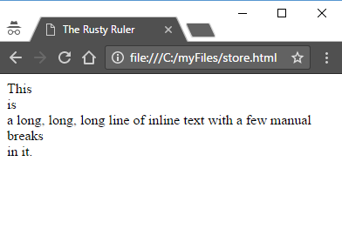
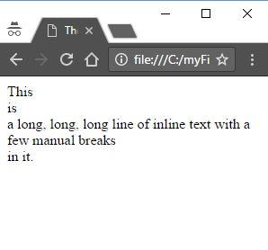
Line Break
<p>This<br>is<br>a long, long,
long line of inline text with
a few manual breaks<br>in it.</p>
Notes:
In my HTML file it looks like the paragraph is 3 lines. But all of the text is inline within the <p> element. It flows left to right and wraps at the end of the screen.
#1 You can use the <br> to force a line return.
There is plenty of room on the line, but the <br> breaks it prematurely.
So how many lines? Trick question. If the browser is wide enough you get the max of 4 because of the three brs here.
#3 Shrink the line and things begin to wrap.
#4 The browser puts this return in to wrap the text
#5
If you could shrink the width enough you’d get down to one word per line. My browser won’t let me shrink anymore than the right picture.
Not as big of a break as the block <p>

Slide 12
Void Elements
<h2>What People Are Saying</h2>
<q>This place is great!</q>
Elements like <h2> and <q> have content. They have a beginning and a matching ending tag.
<img src="store.jpg">
<br>
Elements like <img> and <br> have no content. They have no closing tag.
We call these “void elements”.

Slide 13
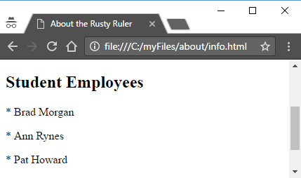
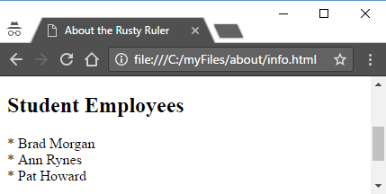
List of Employees
Add a list of Rusty Ruler student-workers to the about page.
<h2>Student Employees</h2>
<p>* Brad Morgan</p>
<p>* Ann Rynes</p>
<p>* Pat Howard</p>
Space?
<h2>Student Employees</h2>
* Brad Morgan<br>
* Ann Rynes<br>
* Pat Howard<br>
No indent?
Dots?
Notes:
#1 Start with a heading
#2 How about paragraphs? These are separate paragraphs after all.
#3 Looks … well, it is a list
#4 The spacing is a little bad
#5 We know lots of HTML. How about the <br> tag?
#6 As before
#7 Looks better
#8 But we’d like the list to be indented a little
#9 And we want dots … filled circles … here. Not asterisks.
AND it should bother you that we are drawing the list. You probably want an element to tell the browser about the list and let it do the work.

Slide 14
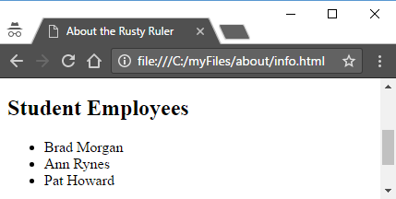
The List Item
<h2>Student Employees</h2>
<ul>
<li>Brad Morgan</li>
<li>Ann Rynes</li>
<li>Pat Howard</li>
</ul>
The <ul> … </ul> identifies an Unordered List
The <li> … </li> identifies the List Items themselves

Slide 15
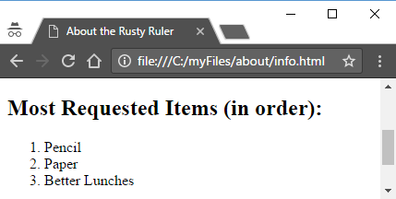
Ordered Lists
<h2>Most Requested Items (in order):</h2>
<ol>
<li>Pencil</li>
<li>Paper</li>
<li>Better Lunches</li>
</ol>
The <ol> … </ol> identifies an Ordered List
The <li> … </li> identifies the List Items themselves

Slide 16
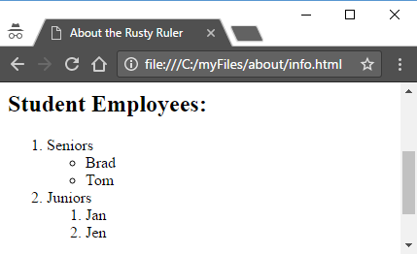
Complex Lists
<h2>Student Employees:</h2>
<ol>
<li>Seniors
<ul>
<li>Brad</li>
<li>Tom</li>
</ul>
</li>
<li>Juniors
<ol>
<li>Jan</li>
<li>Jen</li>
</ol>
</li>
</ol>
Notes:
You’ve seen multi-level outlines. HTML allows you to put a list in a list-item to make a sub list. The browser handles the numbering and indentions appropriately.
#1 The outer ordered list has two list items … Seniors and Juniors. Where you expect a closing <li> you find another list. The closing is way down here.
#2 The browser indents the top level items and indents more for the sub list. Notice that at this level the circles are open. Deeper maybe squares? Good exercise to find out.

Slide 17
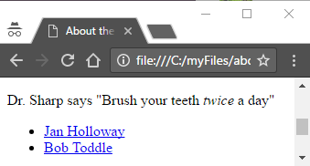
Nesting
<p>Dr. Sharp says <q>Brush your teeth <em>twice</em> a day</q></p>
<ul>
<li><a href="jan.html">Jan Holloway</a></li>
<li><a href="bob.html">Bob Toddle</a></li>
</ul>
Often one element can be embedded within another.
Read the documentation for the rules.
Carefully manage the open/close tags.

Slide 18
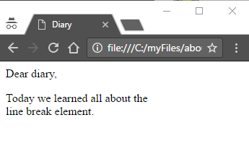
Entities
<html>
<head>
<title>Diary</title>
</head>
<body>
<p>Dear diary,</p>
<p>Today we learned all about
the <br> line break element.</p>
</body>
</html>
Notes:
I decided to keep my diary in HTML … put it up on a server.
Today we learned about the <br> tag! I must tell!
#oops! The <br> is missing! What happened? The browser interpreted it as a break. What if I want to use the text <br> in my paragraph?

Slide 19
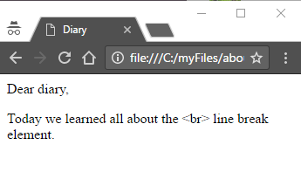
Entities
<p>Today we learned all about the
&lt;br&gt; line break element.</p>
&entity;
Use ampersand-name-semicolon to insert an entity into the text. The browser will convert it but won’t consider it as markup.
&lt; (Less than)
&gt; (Greater than)
https://www.w3schools.com/html/html_entities.asp
&#8209; (Any Unicode character by decimal number)
&#x2030; (Any Unicode character by hex)
Notes:
#1 Much better
#2 Entities are a way of specifying a character by name or code. The syntax is ampersand then the entity name or number and a semicolon.
#3 The browser will convert the character but will not process it as markup
#4 less than (start of a tag)
#5 greater than (end of a tag)
#6 many, many more
#7 In fact, you can use the Unicode number to reference any character. Useful for other languages (like Chinese characters) and special punctuation/symbols. When you need one, a web search will tell you more than you wanted.

Slide 20
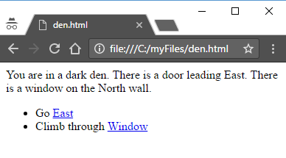

Tinkering
Create a choose-your-own-adventure game.
Each room is an HTML page. Use hypertext links between the rooms.
Use an unordered list for options in each room.
Add pictures and creative descriptions.
Hall
Den
Study
Kitchen

